Slide 1
C3

Slide 2
CONVERSATIONAL CONSTRAINED CLUSTERING
Project of Anh Quan Nguyen

Slide 3
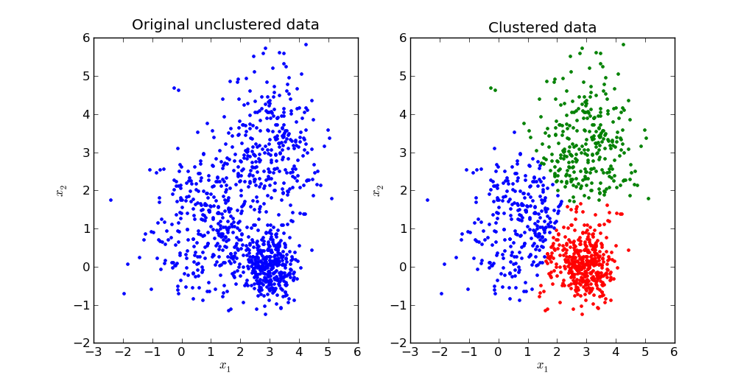

Slide 4
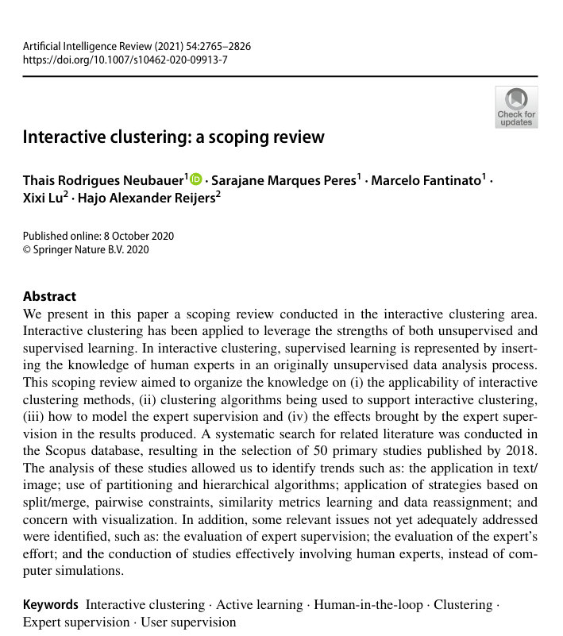

Slide 5
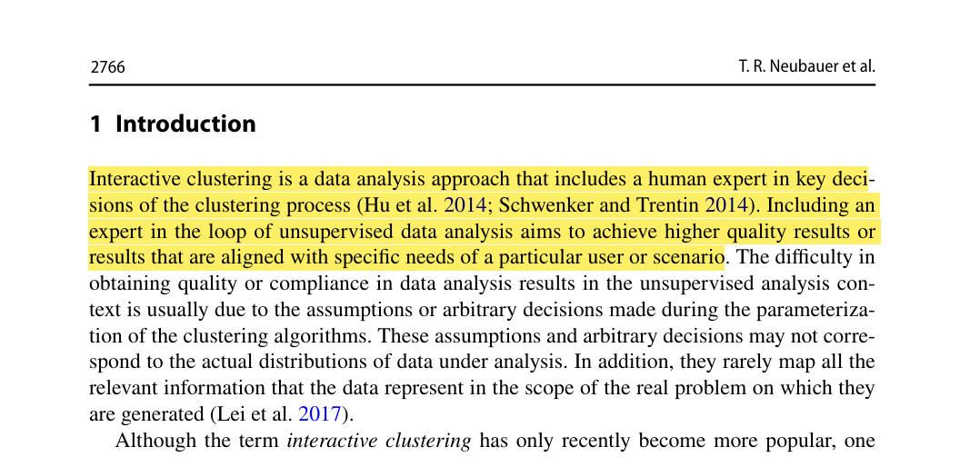

Slide 6
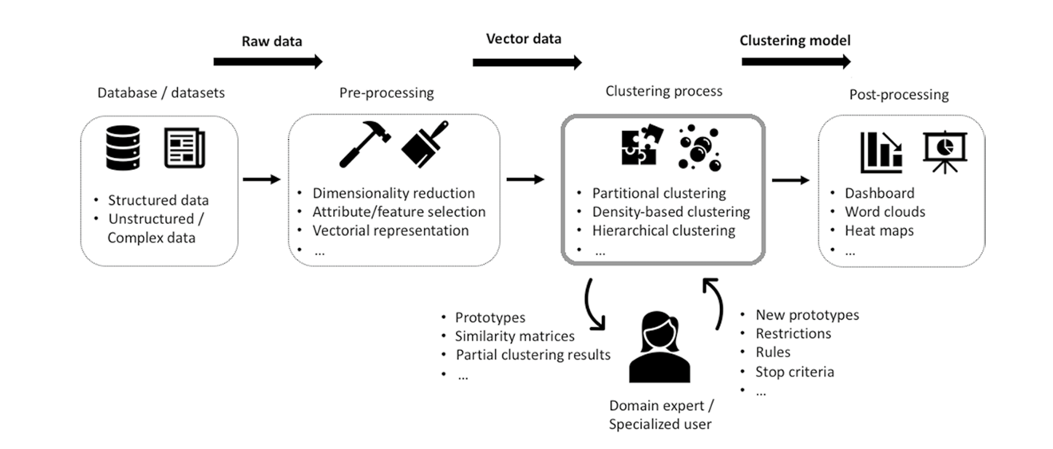

Slide 7
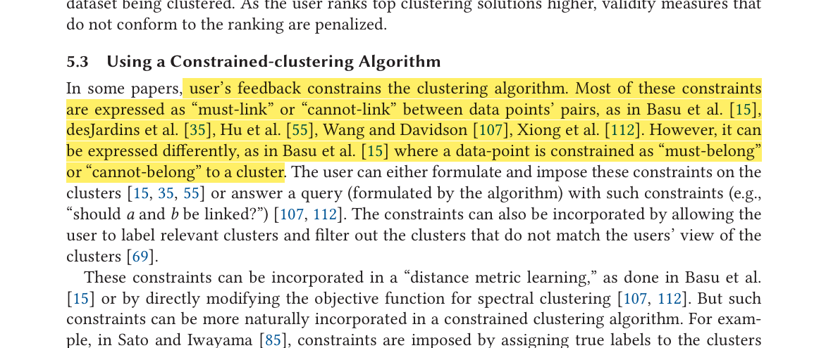

Slide 8
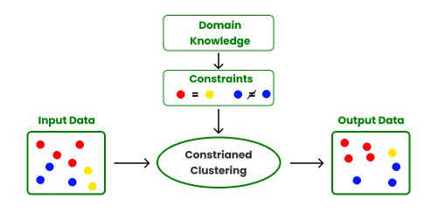

PCK-Means, COP-Kmeans, Constrained Spectral Clustering, ...

Slide 9


Slide 10
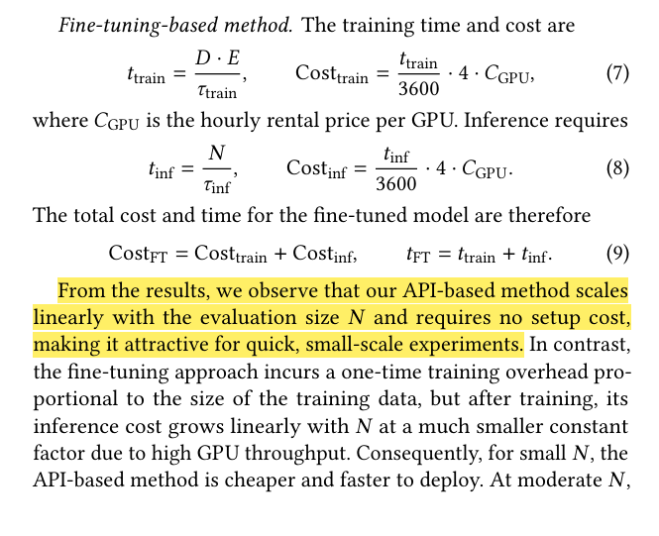
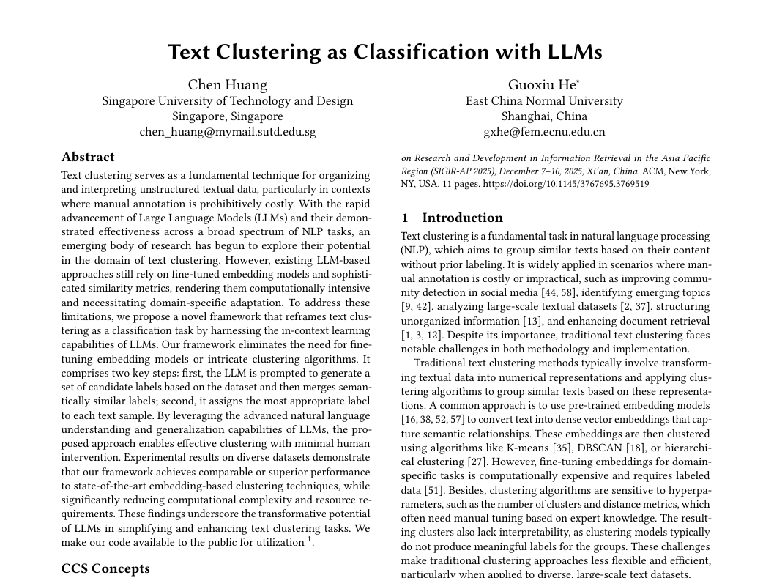
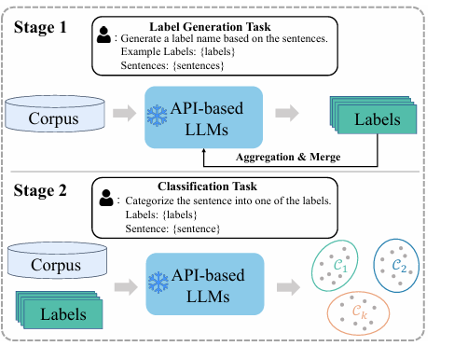

Slide 11
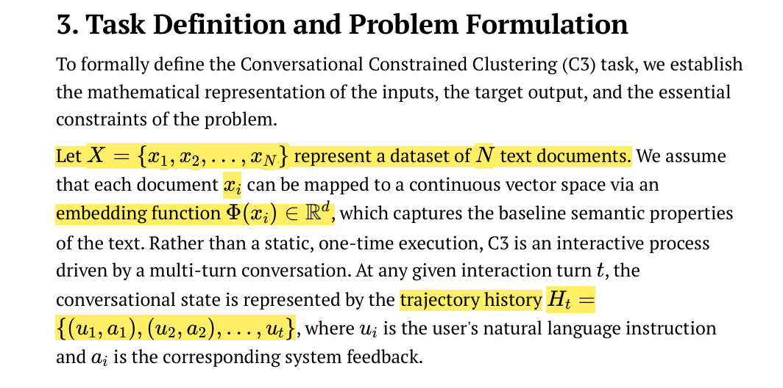

Slide 12
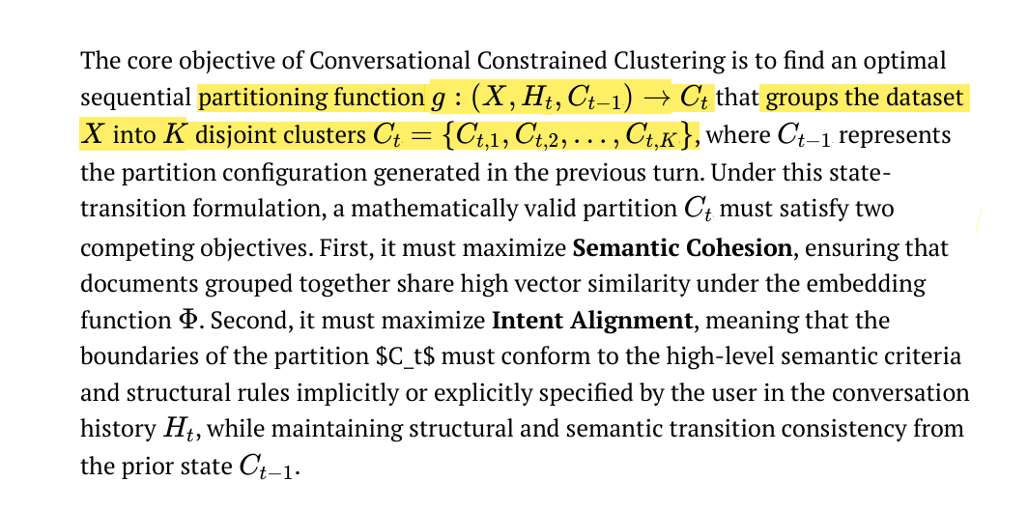

Slide 13


Slide 14


Slide 15


Slide 16


Slide 17


Slide 18


Slide 19
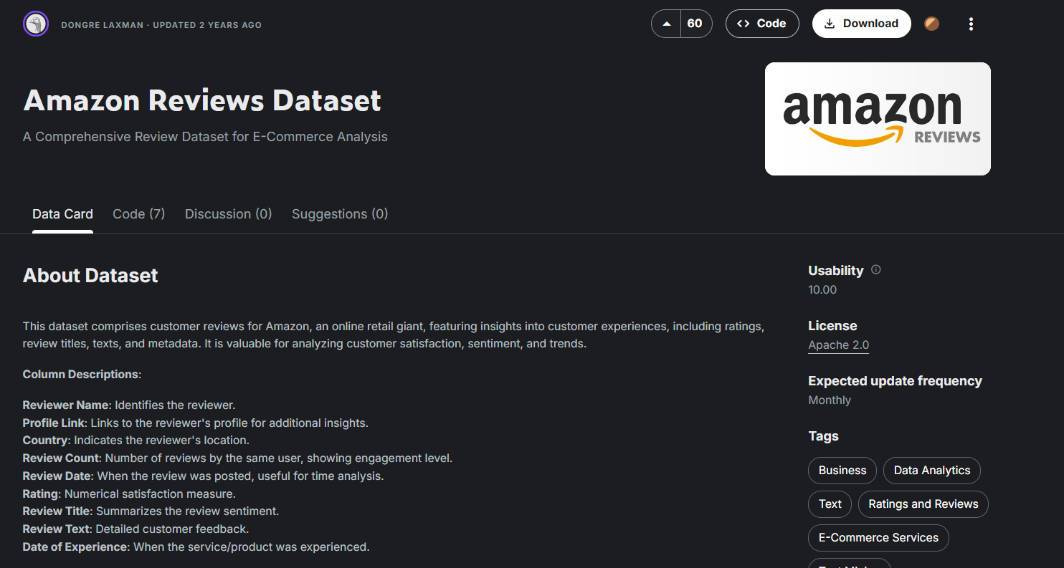

Slide 20

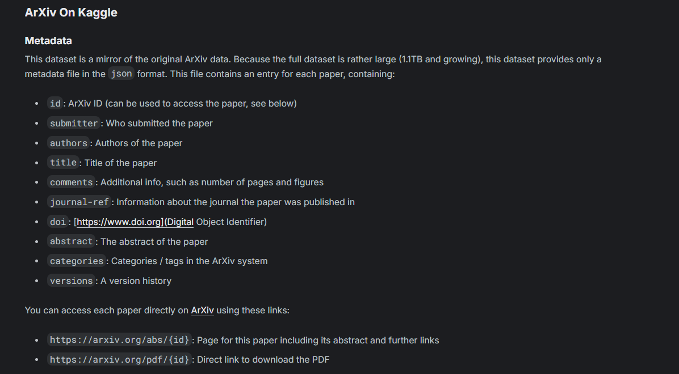

Slide 21



